Slide 1
Art of Data Visualization
By
Dr. Rauf Ahmed Shams Malick

Slide 2
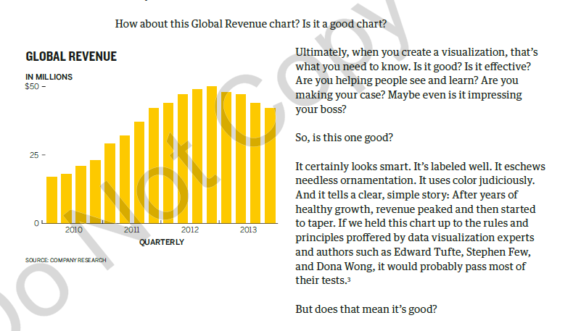
What is a good chart?

Slide 3
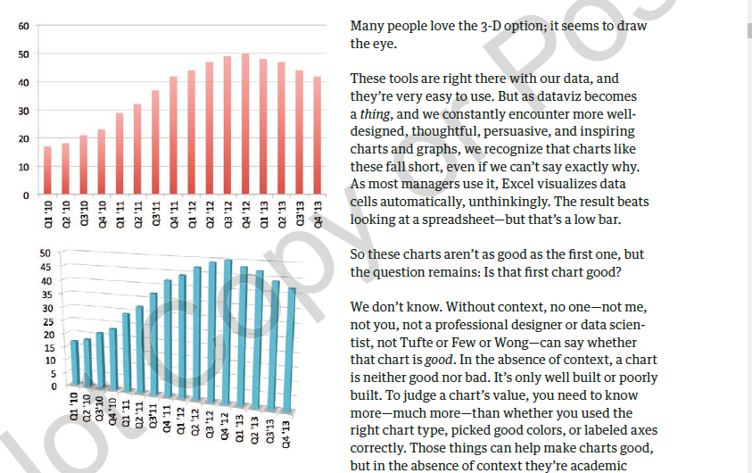

Slide 4
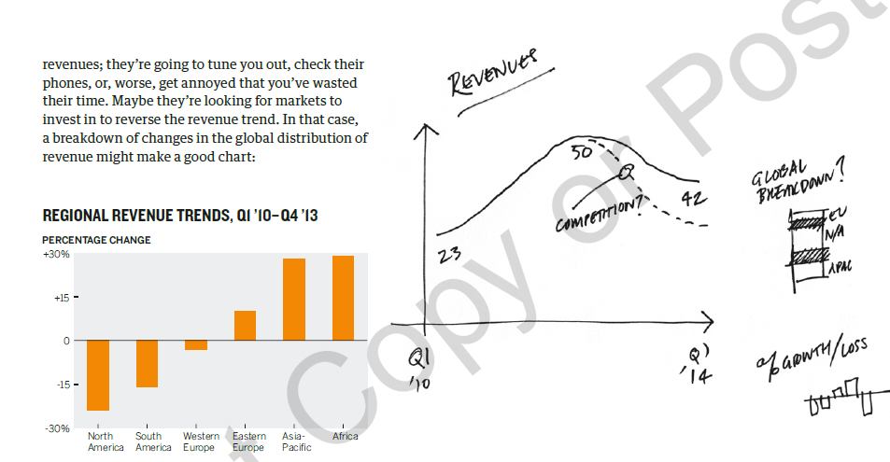

Slide 5
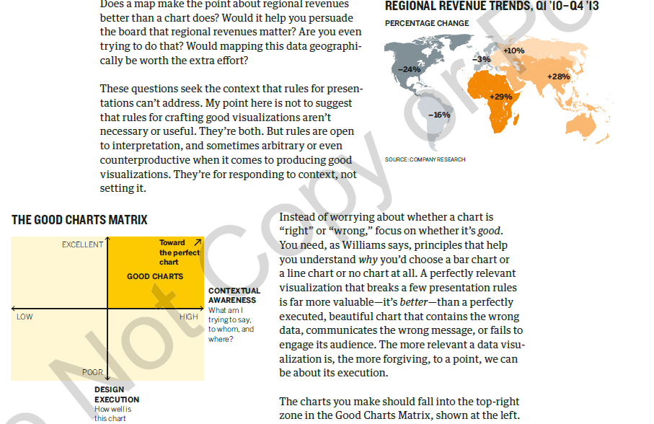

Slide 6
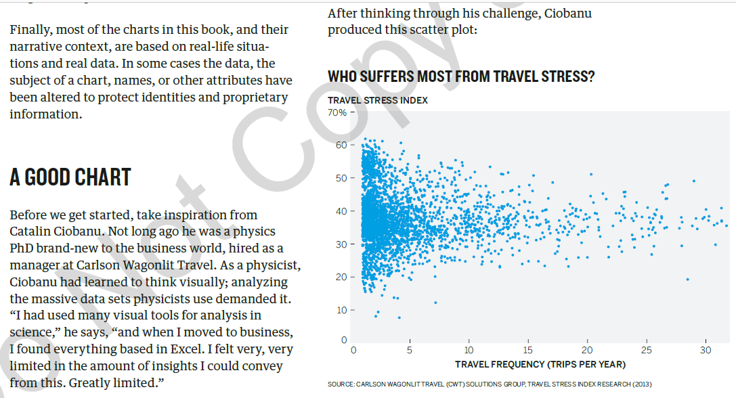

Slide 7
